Slide 1


Data
Analysis
On Social Buzz
Notes:
Hello and welcome, my name is Rahul C Jadhav, and today I will be presenting to you the results of the Data Analytics on SOCIAL BUZZ

Slide 2


Today's agenda
Project recap
Problem
The Analytics team
Process
Insights
Summary
Notes:
Today's agenda will be as follows:
Overview: We'll start by giving you an easy-to-understand summary of the entire project, explaining the main business problem we're addressing and the specific requirements we need to meet.
The Problem: Next, we'll delve into the specific challenge our Data Analytics team has been working on. We'll explain why this problem is significant and how it impacts our overall objectives.
Our Team: We'll introduce the members of our team who are responsible for tackling this task. They bring unique skills and expertise to ensure we get the best possible results.
The Process: We'll walk you through the step-by-step approach we followed to complete this task. This will help you grasp how we handle similar tasks and ensure transparency in our methods.
The Results: Finally, we'll share the most crucial part – the results! We'll present the valuable insights and visualizations we gained from our analysis. These findings will shed light on important aspects related to the project.
To wrap up, I will summarize and open for any questions.

Slide 3

Social Buzz is a fast growing technology unicorn that need to adapt quickly to it's global scale. Accenture has begun a 2month POC focusing on these tasks:
An audit of Social Buzz's big data practice
Recommendations for a successful IPO
Analysis to find Social Buzz's top 5 most popular categories of content
Project Recap
Notes:
Here are the main tasks we are focusing on:
Big Data Practice Audit: We are examining how Social Buzz handles their large amount of data. We will share the best ways to manage this data based on our industry knowledge and expertise.
IPO Guidance: Social Buzz is planning to go public, and we will be there to support them throughout this process. We have experience with successful IPOs and will help ensure everything goes smoothly.
Content Analysis: We analyzed Social Buzz's data to find out what types of content are the most popular among their audience. This information will help them create more engaging content.
Our goal i

Slide 4

Problem
Over 110000 posts per day
36,500,000 pieces of content
per year!
But how to capitalize on it when there is so much?
Analysis to find Social Buzz's top 5 most popular categories of content
Notes:
The focus of our Data Analytics team has been on a critical aspect related to Social Buzz's massive scale of operations and the challenges it poses.
To give you some context, Social Buzz generates an enormous amount of data daily – over 100,000 posts, adding up to a staggering 36,500,000 posts each year. However, all this data is unstructured, making it challenging to extract valuable insights from it.
In today's world, content plays a pivotal role, as seen with major platforms like YouTube, Facebook, and Netflix, which are primarily content-driven businesses. The key lies in effectively capitalizing on this abundance of content.
Yet, it's not just about amassing vast amounts of content. The real value lies in comprehending and analyzing this data to gain a deeper understanding of the audience. By doing so, Social Buzz can offer a more personalized and enjoyable experience to its users.
Here's where our data analytics expertise comes into play. Through this task, we have gained invaluable insights that demonstrate how analytics can be effectively implemented at scale. These insights will empower Social Buzz to harness the true potential of their data, enhancing their operations and providing a more engaging user experience.
In summary, our Data Analytics team's efforts have been centered around leveraging data to unlock opportunities for Social Buzz and enable them to thrive in a content-driven world. The outcomes of our analysis will guide them in taking data analytics to the next level and achieving a remarkable impact on their platform.

Slide 5



ANDREW FLEMING
Chief Technology Architect
The Analytics team
MARCUS ROMPTON
Senior Principal
Rahul C. Jadhav
Data Analyst
Notes:
Talking about experience, we have a large data analytics practice at Accenture but we had a team of 3 people primarily focusing on this task. Andrew Fleming is our Chief Technical Architect and his expertise really helped to guide the team to produce high quality analysis.
Marcus Rompton, a senior principal has worked with the worlds biggest clients on solving their data problems and was heavily involved in the data engineering side of this project.
And finally myself, Shivani Mishra, who was solely responsible for taking leadership guidance and delivering high quality insights from the raw datasets and turning these into business decisions.

Slide 6
Process
1
Data Understanding
2
Data Cleaning
3
Data Modelling
4
Data Analysis
5
Uncover Insights
Notes:
So, how did we tackle this problem?
Well we approached it in 5 steps:
1. Data understanding - the key to success on any data project is to understand the data in detail. So we took the time to understand the data model and domain of your business.
2. Data cleaning - after understanding your business, we then cleaned the available datasets and thought about what an ideal dataset should look like for this problem.
3. Data modelling - After ensuring the data was clean for analysis, we needed to process and model this data into a dataset that can precisely answer the business questions and produce the results needed.
4. Data analysis - With our new dataset, we used our analytical expertise to uncover insights from this dataset and to produce visualizations to describe the insights.
5. And finally we used these insights to unlock business decisions and to make recommendations on next steps.

Slide 7

Insights
16
1738
JANUARY
UNIQUE
CATEGORIES
REACTIONS TO "ANIMAL" POSTS
MONTH WITH
MOST POSTS
Notes:
From your data we found that you had a total of 16 unique categories of posts across your sample dataset. This includes things such as Food, Culture and Sport.
As well as this, there were 1897 reactions from just the animal category alone! People obviously really like animals!
And also the most common month for users to post within was January. This aligns with seasonal trends of social media users that feel the need to reconnect with people after calendar events such as Christmas.
But now, onto the main question... which is... what were the top 5 most popular categories of posts?

Slide 8
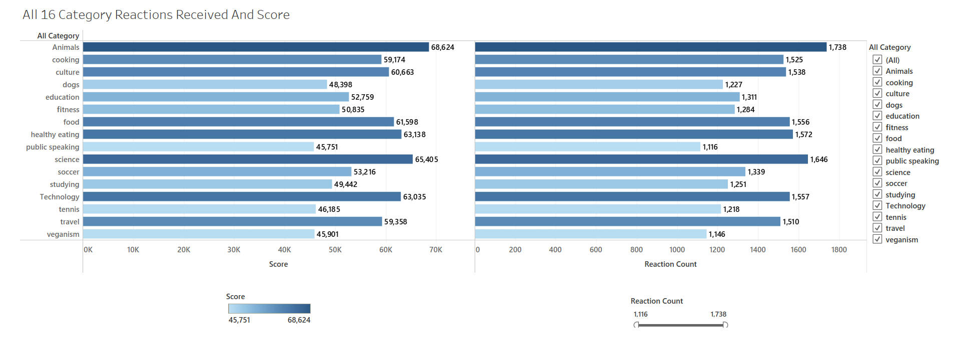
Notes:
From our analysis, you can see that the top 16 most popular categories of posts in descending order.
We wanted to give you an overall number for you future planning too

Slide 9
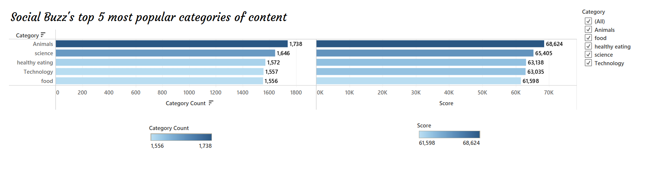
Notes:
Based on our analysis, we found that the top 5 most popular categories of posts are animals, science, healthy eating, technology, and food, in descending order of popularity.
Animals received the highest aggregate popularity score, reaching around 68,624. It's intriguing to note that both food and healthy eating made it to the top 5, indicating that food-related content is highly engaging.
Furthermore, healthy eating ranked slightly higher than food, suggesting that your user base may have a significant number of health-conscious individuals.
Additionally, we observed a strong interest in science and technology content. This suggests that people enjoy consuming factual information and snippets of knowledge they can learn from.
These insights provide valuable information about what resonates with your audience and can help guide your content strategy to enhance user engagement and satisfaction.

Slide 10
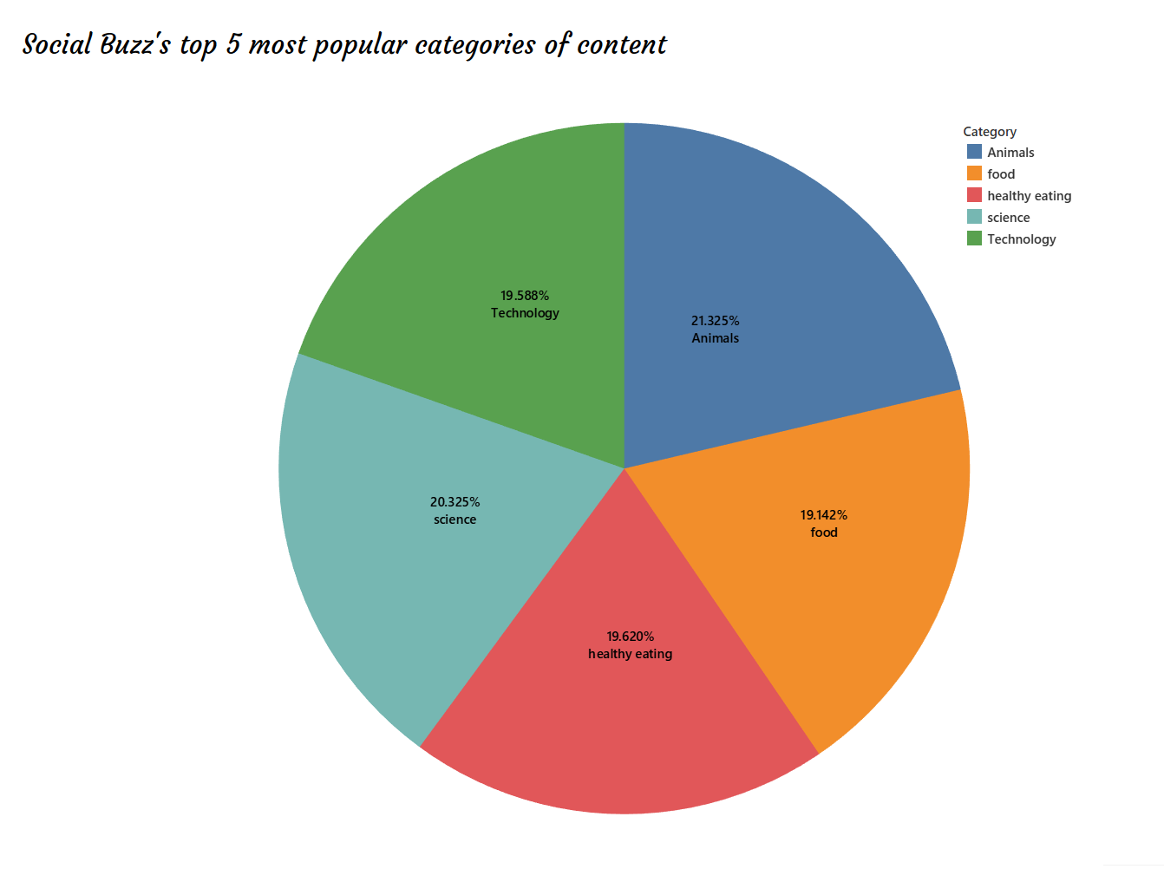
Notes:
Furthermore, the chart illustrates the percentage split of popularity among the top 5 categories. Although there is not a significant difference between the shares of each category, the variance between the 1st most popular, animals, and the 2nd most popular, science, is the largest, with just a 1% gap.
From a business perspective, this observation suggests that the most popular category, animals, seems to be pulling ahead of the others and might continue to gain even more popularity.
To prevent a situation where one content category dominates the entire platform, it will be crucial to ensure that any algorithms governing content distribution maintain a fair balance among the different categories.
By maintaining equitable exposure and promoting diversity in content, you can foster engagement across various interests and ensure a well-rounded and inclusive user experience.

Slide 11
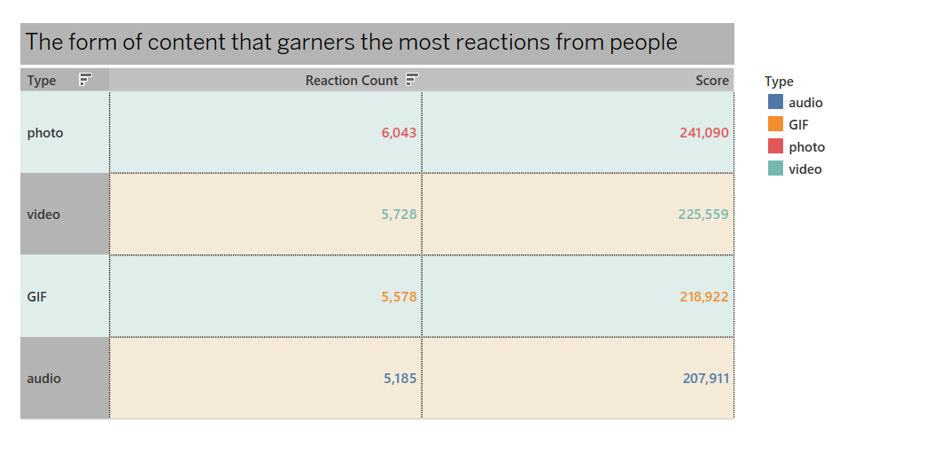
Notes:
According to this ghraph the most amount of form of content consumed by people are photo and video

Slide 12

Summary
ANALYSIS
Animals and science are the two most popular categories of content, showing that people enjoy "real-life" and "factual" content the most.
INSIGHT
Food is a common theme with the top 5 categories with "Healthy Eating" ranking the highest. This may give an indication to the audience within your user base. You could use this insight to create a campaign and work with healthy eating brands to boost user engagement.
NEXT STEPS
The ad-hoc analysis provided valuable insights, but now it's essential to scale it up for real-time understanding of your business.
We are equipped to guide you in implementing this analysis at a large scale, enabling you to gain immediate and continuous insights into your operations.
Our expertise will help you leverage data effectively and make informed decisions to drive your business forward.
Notes:
In our endeavor, we not only identified the top 5 most popular categories as requested but also delved deeper into the analysis.
The findings revealed that animals and science stand out as the two most sought-after categories, indicating a strong preference for "real-life" and fact-based content among users.
Additionally, we discovered that food, especially healthy eating, holds a prominent position among popular content. This valuable insight could be utilized to enhance engagement further. For instance, you might consider running a targeted campaign centered around this category or collaborating with health-conscious brands to promote relevant content.
While the analysis provided valuable insights, we are prepared to take it to the next level. At Accenture, we possess the expertise required to implement real-time insights across your organization, enabling you to make data-driven decisions. We are eager to support you in this endeavor.

Slide 13
Thank you!
ANY QUESTIONS?
Notes:
Thank you for listening. I am open to any inquiries you might have. Please feel free to ask any questions.

